Slide 1
Best Practices in K-12 Mathematics for Gifted Learners: Examining and Incorporating National Guidance Documents
November 29th, 2021

Slide 2
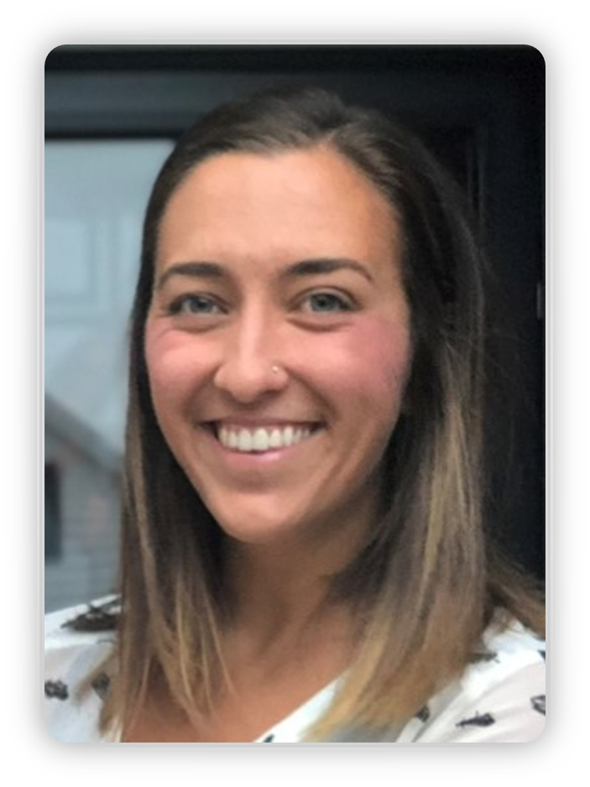
Today’s Presenter: Megan Vermillion
Education Program Specialist for Gifted Services
Bachelor's Degree in Early Childhood Education and Special Education from Capital University
Master's Degree in Curriculum and Instruction with a focus in Gifted Education from Cleveland State University
5 years teaching experience as a Gifted Intervention Specialist and General Education teacher

Slide 3
Today’s Discussion
NCTM's Effective Mathematics Teaching Practices
NAGC's Gifted Programming Standards
Connections between guidance and interactive examples

Slide 4
NCTM's Effective Mathematics Teaching Practices
Click here for link
Establish mathematics goals to focus learning
Implement tasks that promote reasoning and problem solving
Use and connect mathematical representations
Facilitate meaningful mathematical discourse
Pose purposeful questions
Build procedural fluency from conceptual understanding
Support productive struggle in learning mathematics
Elicit and use evidence of student thinking

Slide 5
NAGC's Gifted Programming Standards
Learning and Development
Assessment
Curriculum and Instruction
Learning Environments
Programming
Professional Learning
Click here for link

Slide 6
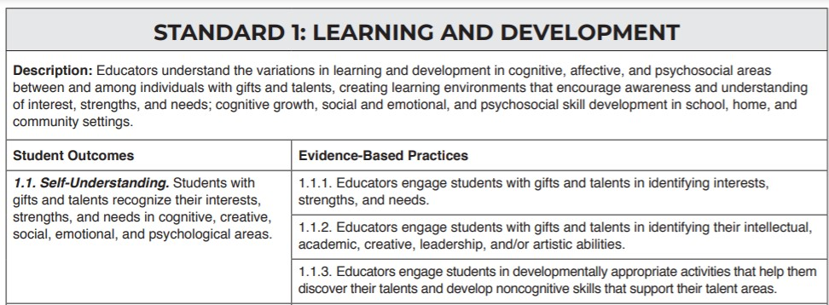
Organization of Programming Standards
Basic font sizes
Bullet points, lines and shapes
Numbers
Notes:
Each standard contains a description.
Further broken down into Student Outcomes and then multiple Evidence-Based Practices for each outcome

Slide 7
Presentation Layout: Discussing Connections and Interactive Practice
Connection between NAGC and NCTM
Interactive Task #1
Connection between NAGC and
NCTM
Interactive Task #2
Connection between NAGC and NCTM
Interactive Task #3
Notes:
Explains the format of the rest of presentation

Slide 8
Establish mathematics goals to focus learning. Effective teaching of mathematics establishes clear goals for the mathematics that students are learning, situates goals within learning progressions, and uses the goals to guide instructional decisions.
3.5.1. Educators model and teach metacognitive models to meet the needs of students with gifts and talents such as self-assessment, goal setting, and monitoring of learning.
Allowing students to be part of goal setting process
Students engaged in progress monitoring
Notes:
Left side- NCTM Effective Mathematics Teaching Practices, Right Side- Aligning NAGC's Gifted Programming Standards
Taking this a step further- students should be setting goals, designing essential questions together, deciding what goals they have as individuals and as a class for the work they are doing

Slide 9
Support productive struggle in learning mathematics. Effective teaching of mathematics consistently provides students, individually and collectively, with opportunities and supports to engage in productive struggle as they grapple with mathematical ideas and relationships.
4.1.4. Educators provide feedback that promotes perseverance and resilience and focuses on effort, on evidence of potential to meet high standards, and on mistakes as learning opportunities.
.
4.1.5. Educators provide examples of positive coping skills and opportunities to apply them
Notes:
Focus on Growth Mindset

Slide 10
Interactive Task #1
How are your math goals determined currently? For each lesson? Unit? Topic? How are they shared with students?
How involved are students in this process? Goal Setting? Progress monitoring?
Brianstorm a list of ways you could incorporate more student involvement in this process. How does this look in your classroom?
What is celebrated in your classroom? What does success look like in your eyes? In the eyes of your students?
List additional ways to promote and celebrate productive struggle in your classroom. Type an idea in the chat.

Slide 11
Example
More Student Involvement in Goal Setting
“Set simple, clear, specific goals that move them toward getting something accomplished (approach goals) rather than avoiding something (avoidance goals)” –Janette Boazman, NAGC
Practice of SMART goals
Provide list of goal templates for students to self-select
Individual and class incentives to meet goals
Focused on process rather than product
Celebrating Productive Struggle
Celebrating Productive Struggle
Changing what we compliment and celebrate- “You worked so hard” vs. “You are so smart”
“Shout outs” for productive struggle from both teacher and classmates
Assigning tasks that promote not getting the answer the first time or that have more than one correct answer

Slide 12
Facilitate meaningful mathematical discourse. Effective teaching of mathematics facilitates discourse among students to build shared understanding of mathematical ideas by analyzing and comparing student approaches and arguments.
4.2. Social Competence. Students with gifts and talents develop social competence manifested in positive peer relationships and social interactions.
4.2.3. Educators assess and provide instruction on psychosocial and social and emotional skills needed for success in school, their community, and society.
Notes:
Social skills aren't always inherent. We need to help students develop these skills in the context of our learning. Students need opportunities to question, explain thinking, and experience productive struggle together

Slide 13
Pose purposeful questions. Effective teaching of mathematics uses purposeful questions to assess and advance students’ reasoning and sense making about important mathematical ideas and relationships.
3.4.3. Educators use models of inquiry to engage students in critical thinking, creative thinking, and problem-solving strategies, particularly in their domain(s) of talent, both to reveal and address the needs of students with gifts and talents.
Taking posing a question a step further...
How can questions guide the whole learning process?
Notes:
Assess and advance connected to reveal and address
Might be helpful to display a bank of questions or question stems for yourself and for students

Slide 14
Four Forms of Inquiry
Confirmation Inquiry
Structured Inquiry
Guided Inquiry
Open Inquiry
Notes:
Source: https://elearningindustry.com/inquiry-based-learning-model:
Confirmation inquiry- Learners are given a question, as well as a method, to which the result is already known. The goal is to confirm the results. This enables learners to reinforce already established ideas, and to practice their investigative skills.
Structured Inquiry- Learners are given the question and the method of achieving the result, but the goal is to provide an explanation that is already supported by the evidence gathered during and through the investigative process.
Guided Inquiry- Learners are only given a question. The main goal is to design the method of investigation and then test the question itself.
Open Inquiry- Learners must form their own questions, design investigative methods, and then carry out the inquiry itself.

Slide 15
Interactive Task #2
Choose one of the four forms of inquiry.
Design a way for this be incorporated into your classroom.
How will meaningful mathematical discourse be practiced in this incorporation?
What will be the role of the students and the teacher in this incorporation?
Join breakout room and discuss these ideas with your group.
Notes:
Design a way for this be incorporated into your classroom
As a daily math problem?
As an introduction to a new unit?
As a math center?
As a culminating project?

Slide 16
Example: Open Inquiry
Genius Hour
Video Explanation
Role of teacher and student
Setting up guidelines ahead of time
Planning check-ins
Mathematical Discourse
Group settings
Meetings with teacher
Culminating presentation

Slide 17
Implement tasks that promote reasoning and problem solving. Effective teaching of mathematics engages students in solving and discussing tasks that promote mathematical reasoning and problem solving and allow multiple entry points and varied solution strategies.
3.1.5. Educators regularly use pre-assessments, formative assessments, and summative assessments to identify students’ strengths and needs, develop differentiated content, and adjust instructional plans based on progress monitoring.
Using student needs to set up productive struggle
Reasoning and problem solving won’t look the same for all
Notes:
Teachers doing the work on the planning side so that students are doing the work during class...if we are working harder than the students, something needs to change

Slide 18
Elicit and use evidence of student thinking. Effective teaching of mathematics uses evidence of student thinking to assess progress toward mathematical understanding and to adjust instruction continually in ways that support and extend learning.
2.4.4. Educators use and interpret qualitative and quantitative assessment information to develop a profile of the interests, strengths and needs of each student with gifts and talents to plan appropriate interventions.
Can be quick notes:
Think checklists, symbols to represent levels of understanding
Notes:
Example of checklists to organize students in "think, share, compare" routine

Slide 19
Interactive Task #3
Think about your current assessment process- (pre- assessment, formative and summative)
Start small- how can you streamline one of your assessments?
How will you use these assessments to adjust content for students and "develop tasks that promote reasoning and problem solving”?
Join breakout rooms to discuss answers to these questions.
Notes:
(Shouldn’t be assessing just to assess or just because there is a provided quiz at the end of the unit, or “we need a grade for the report card”)

Slide 20
Example
BEFORE: Using daily worksheets as lesson post assessment to plan for groups the next day
Ended up with fire kindling by the end of the week and no idea what my students could or couldn’t do...
Switched to exit tickets on notecards that I could easily check and place into groups
BEFORE: Looking at preassessment data by standard before every lesson in order to make small groups for that lesson
Switched to a clipboard with student names and checked whiteboards during active student response time:
+, check, -
Used these to make partnerships for discussions as well as small groups
Notes:
(Shouldn’t be assessing just to assess or just because there is a provided quiz at the end of the unit, or “we need a grade for the report card”)

Slide 21
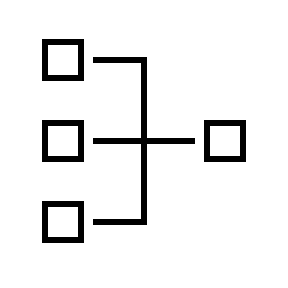
Toolbox Takeaways
Set up easy access to important guidance documents
Set up a system of including students in goal setting and progress monitoring
Choose one form of inquiry to add to an upcoming lesson or topic
n
Try a new efficient assessment strategy
Choose one best practice from national guidance documents to try out in an upcoming lesson
Notes:
Set up easy access to important guidance documents
Bookmark in browser
Print and create a binder or display in room
Set up a system of including students in goal setting and progress monitoring
SMART goals- weekly, monthly, quarterly
Periodic check-ins (can be with a partner, doesn’t have to be with you)

Slide 22
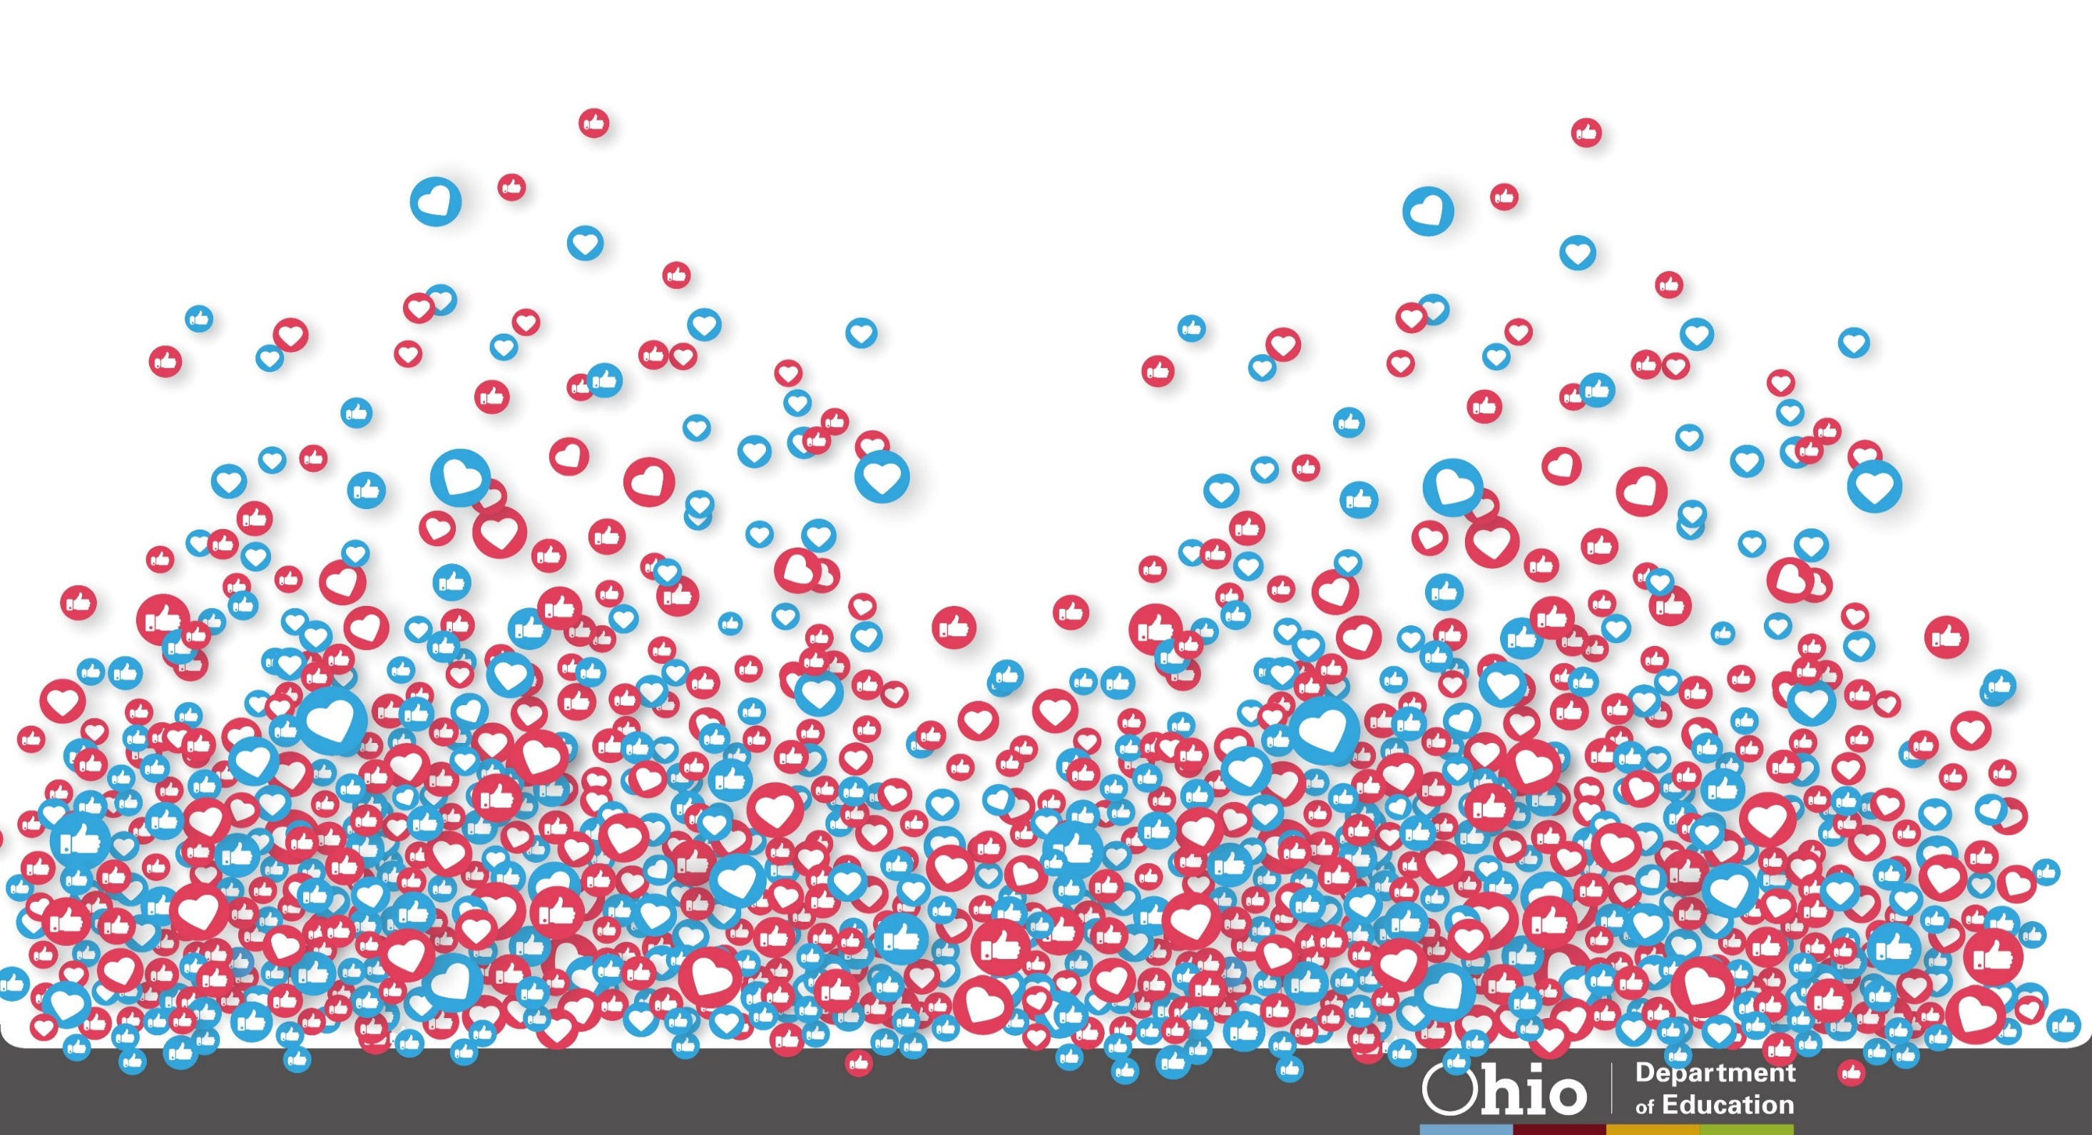
@OHEducation
gifted@education.ohio.gov
Megan.vermillion@education.ohio.gov

Slide 23
Share your learning community with us!
#MyOhioClassroom
Celebrate educators!
#OhioLovesTeachers

